Slide 1
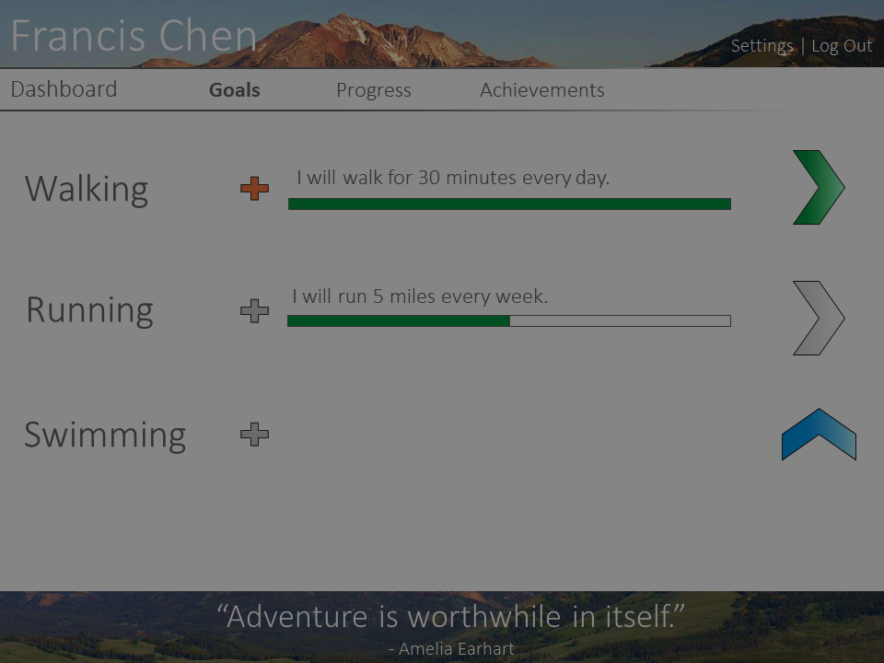
Walking
I will walk for 30 minutes every day.
I will run for 2 miles every week.
I will
do this exercise
for
this much
every
this amount of time
.
Add Goal

